Slide 1

503106
ADVANCED WEB PROGRAMMING
CHAPTER 10: INTEGRATING WITH THIRD-PARTY APIS
LESSON 10 – INTEGRATING WITH THIRD-PARTY APIS

Slide 2
Social Media Plugins and Site Performance
Most social media integration is a frontend affair. You reference the appropriate Javascript files in your page, and it enables both incoming content (the top three stories from your Facebook page, for example) and outgoing content (the ability to tweet abut the page you’re on, for example). While this often represents the easiest path to social media integration, it comes at a cost: page load times double or even triple thanks to the additional HTTP requests.
The code that enables a Facebook “Like” button or a “Tweet” button leverages in-browser cookies to post on the user’s behalf. Moving this functionality to the backend would be difficult (and, in some instances, impossible)

Slide 3
Searching for Tweets
Let’s say that we want to mention the top 10 most recent tweets that contain the hashtag #meadowlarktravel. We could use a frontend component to do this, but it will involve additional HTTP requests.
The easiest and most portable way to access the Twitter API is to create an app and use it to get access tokens (the same with Facebook). (Link http://dev.twitter.com)
Once you have an application, you’ll see that you now have a consumer key and a consumer secret, we can communicate with the Twitter REST API.
Notes:
if we do it on the backend, we have the option of caching the tweets for performance. Also, if we do the searching on the backend, we can “blacklist” uncharitable tweets, which would be more difficult on the frontend.

Slide 4
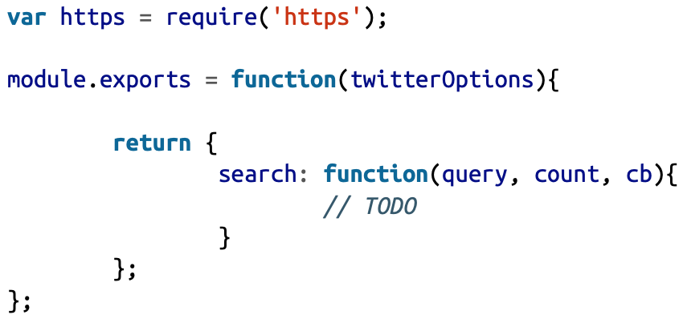
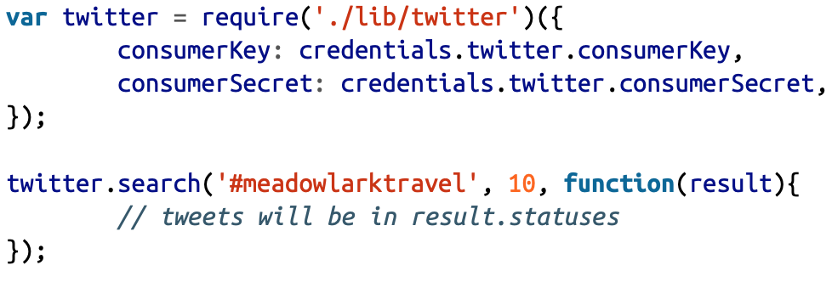
Searching for Tweets
We’ll put our Twitter code in a module called lib/twitter.js:
Then we can call search:

Slide 5
Searching for Tweets
var https = require('https');
module.exports = function(twitterOptions){
// this variable will be invisible outside of this module
var accessToken;
// this function will be invisible outside of this module
function getAccessToken(cb){
// TODO: get access token
}
return {
search: function(query, count, cb){
// TODO
},
};
};
Before we implement the search method, we must provide some functionality to authenticate ourselves to Twitter. The process is simple: we use HTTPS to request an access token based on our consumer key and consumer secret.
Notes:
We only have to do this once: currently, Twitter does not expire access tokens (though you can invalidate them man‐ ually). Since we don’t want to request an access token every time, we’ll cache the access token so we can reuse it.

Slide 6
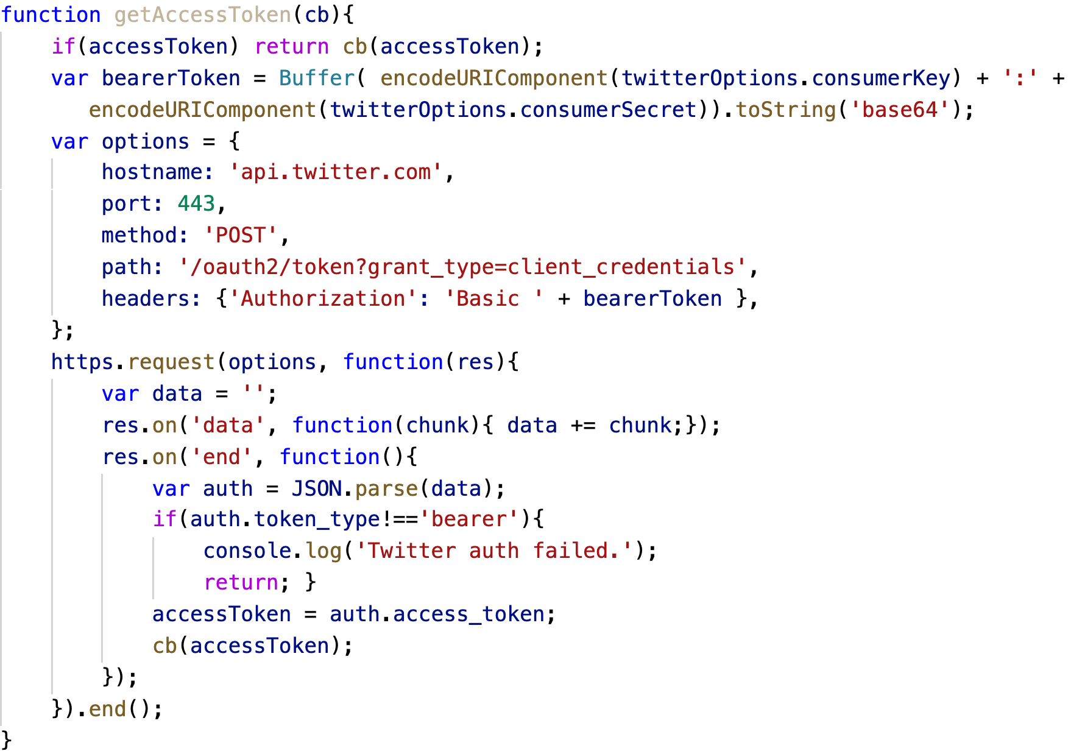
Get access token

Slide 7
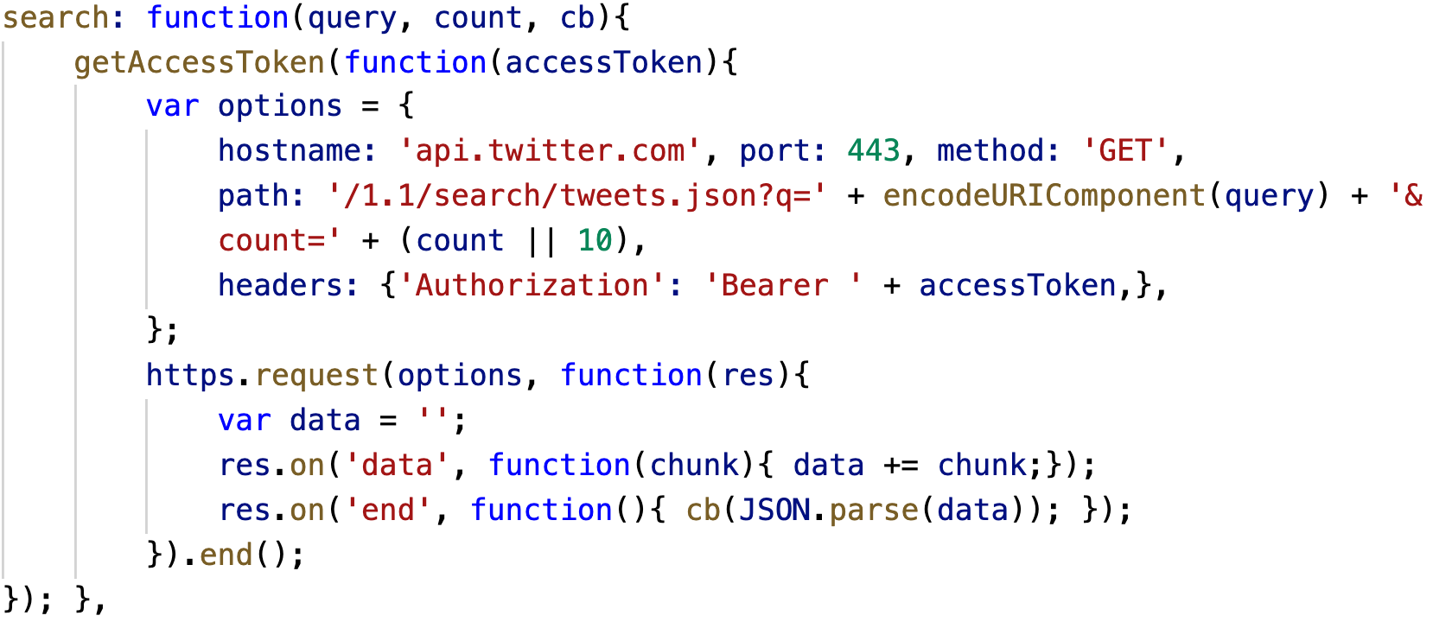
Searching

Slide 8
Rendering Tweets
We’ll use the REST API to search for the tweets and the Twitter widget library to display them. Since we don’t want to run up against usage limits (or slow down our server), we’ll cache the tweets and the HTML to display them for 15 minutes.
We’ll start by modifying our Twitter library to include a method embed, which gets the HTML to display a tweet (make sure you have var querystring = require('query string'); at the top of the file):

Slide 9
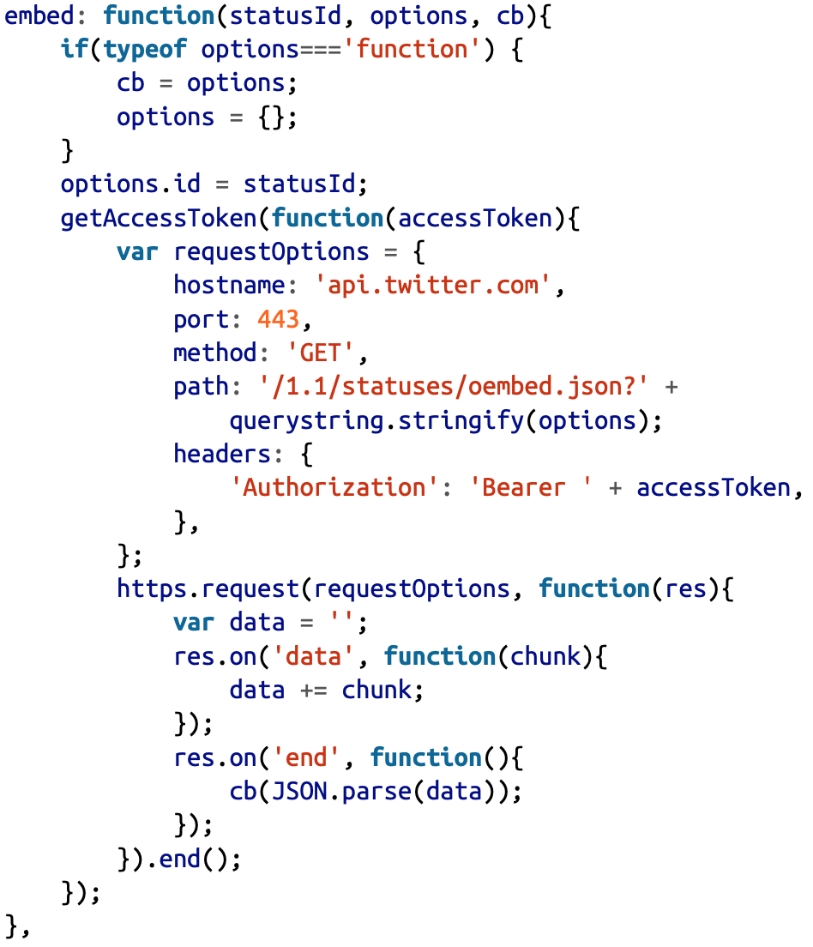
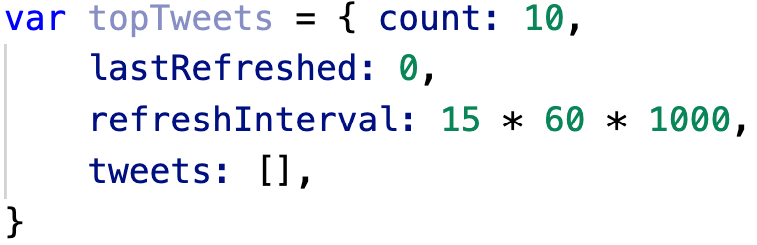
Rendering Tweets
Now we’re ready to search for, and cache, tweets. In our main app file, let’s create an object to store the cache:

Slide 10
Caching Tweets
Next we’ll create a function to get the top tweets. If they’re already cached, and the cache hasn’t expired, we simply return topTweets.tweets. Otherwise, we perform a search and then make repeated calls to embed to get the embeddable HTML.
We’ll use the Q promises library, so make sure you run npm install --save q and put var Q = require(q); at the top of your app file.

Slide 11
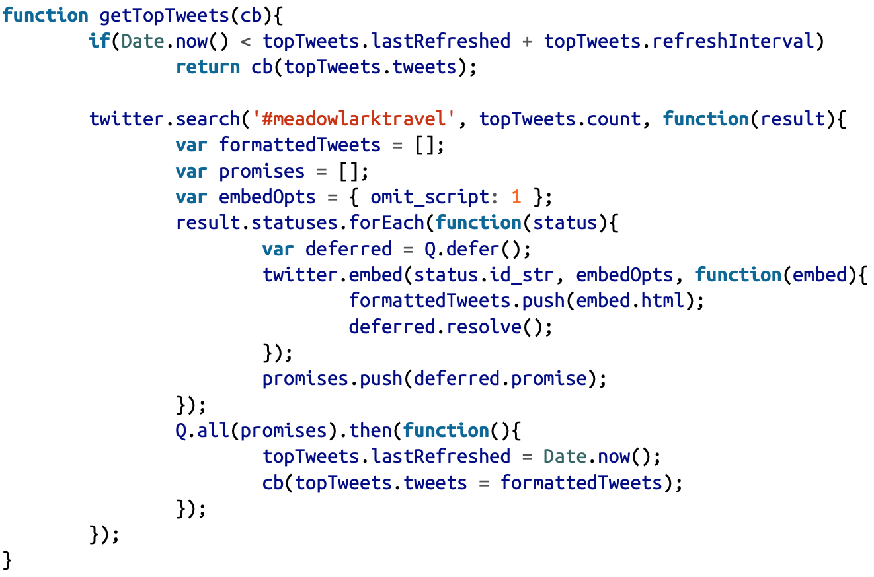
Caching Tweets

Slide 12
Geocoding
Geocoding refers to the process of taking a street address or place name (Bletchley Park, Sherwood Drive, Bletchley, Milton Keynes MK3 6EB, UK) and converting it to geo‐ graphic coordinates (latitude 51.9976597, longitude –0.7406863).
Both Google and Bing offer excellent REST services for Geocoding. We’ll be using Google for our example, but the Bing service is very similar.

Slide 13
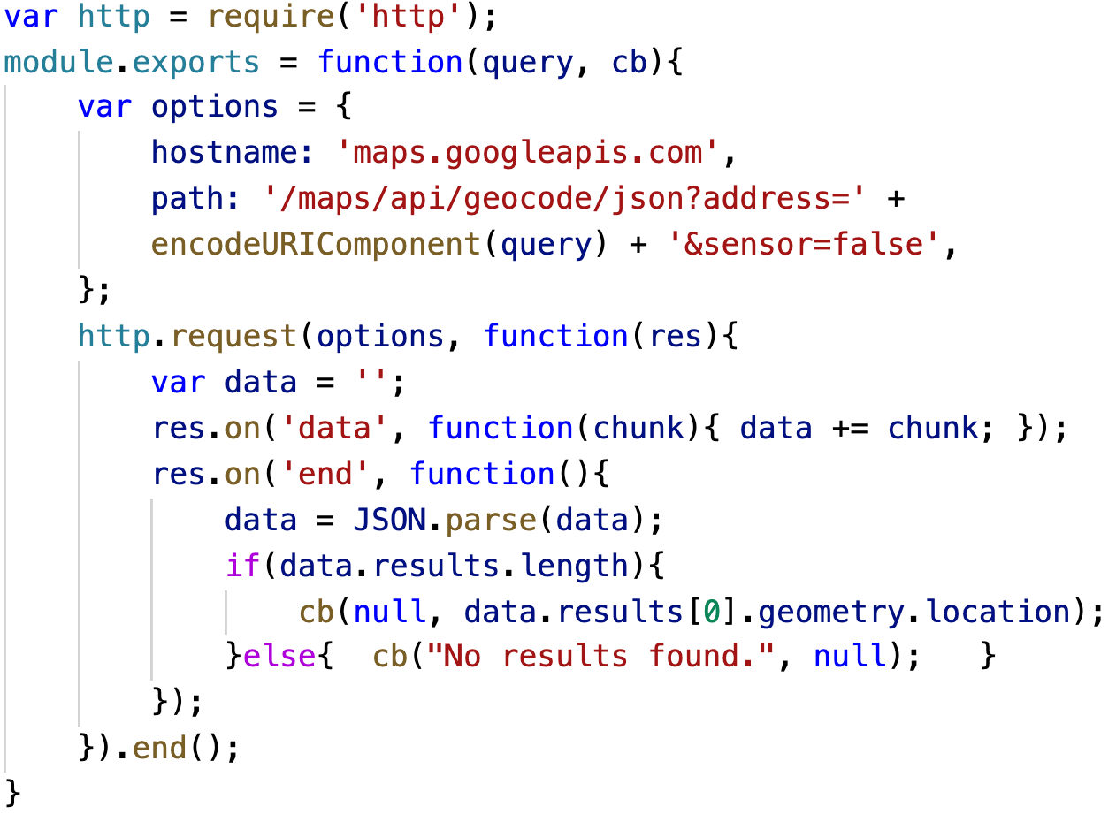
Geocoding with Google
First, let’s create a module lib/geocode.js:
See https://developers.google.com/maps/documentation/geocoding

Slide 14
Geocoding with Google
Both Google and Bing have usage limits for their geocoding API to prevent abuse, but they’re very high. At the time of writing, Google’s limit is 2,500 requests per 24-hour period.

Slide 15
Weather Data
You’ll need to create a free account, which you can do at http://www.wunderground.com/ weather/api/. Once you have your account set up, you’ll create an API key (once you get an API key, put it in your credentials.js file as WeatherUnderground.ApiKey). Use of the free API is subject to usage restrictions (as I write this, you are allowed no more than 500 requests per day, and no more than 10 per minute).

Slide 16
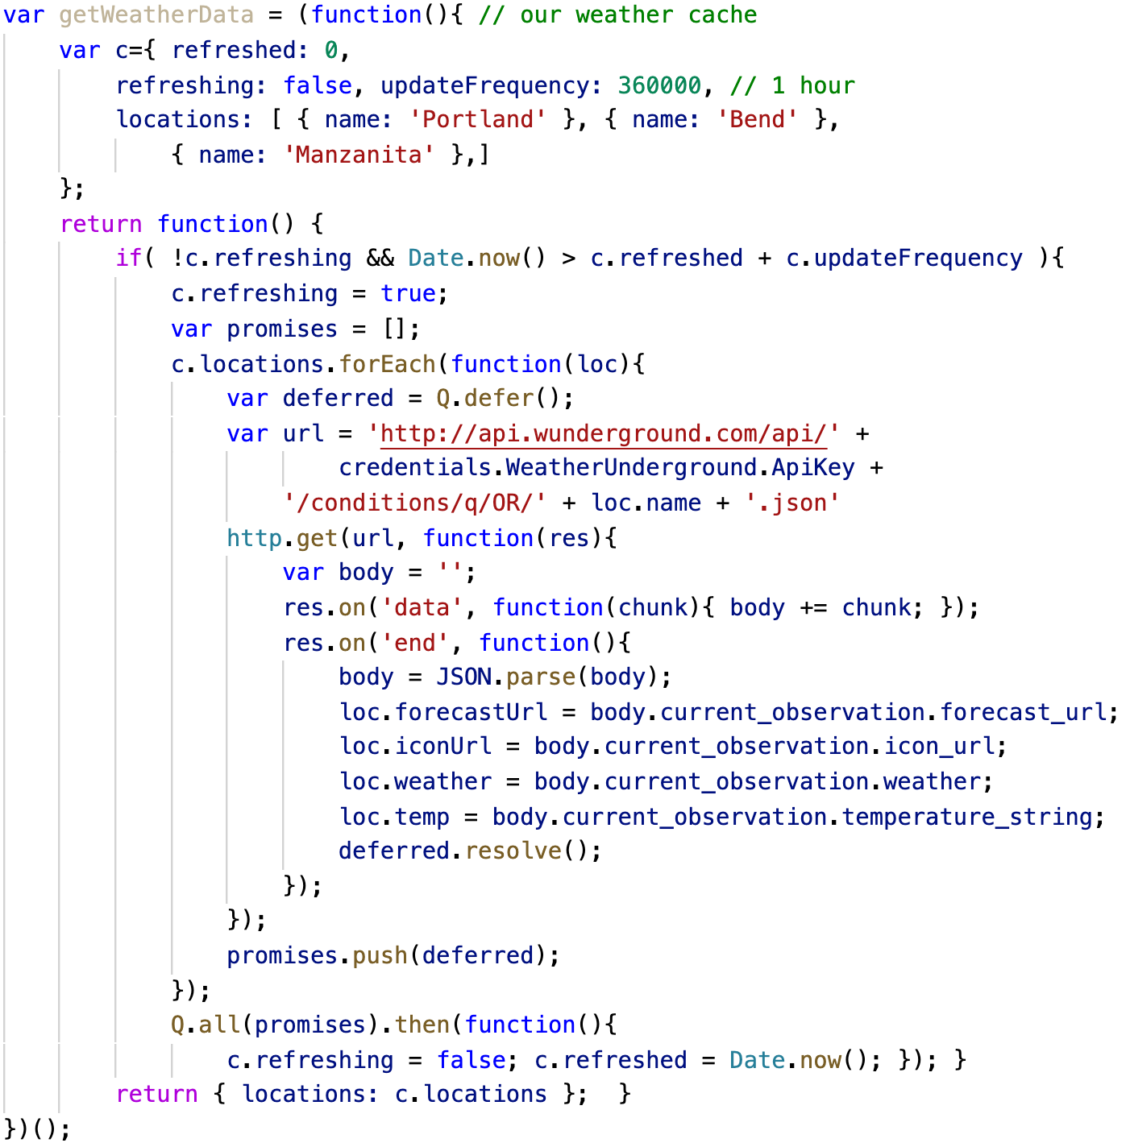
Weather Data
initialize weather cache
getWeatherData();

